Slide 1

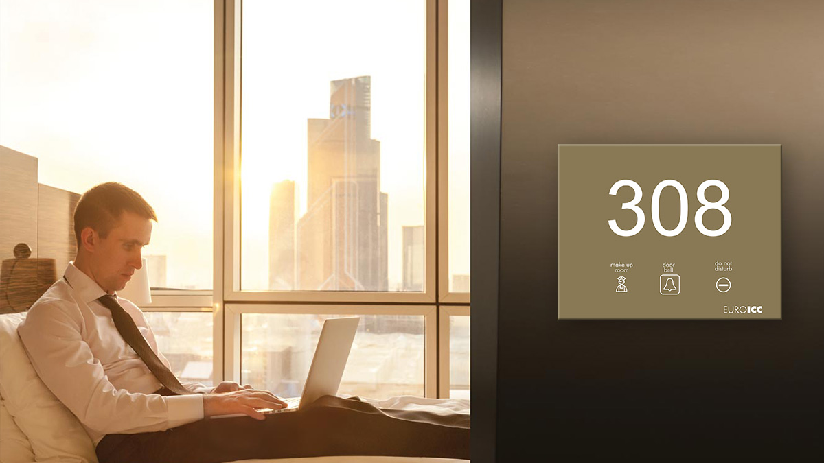

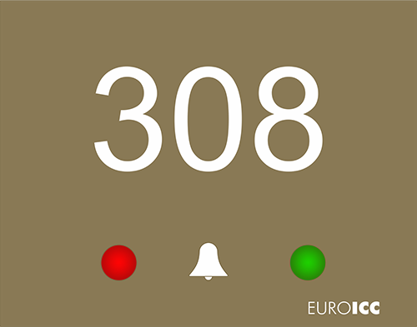
Smart Hotel Control
Energy Management system

Slide 2
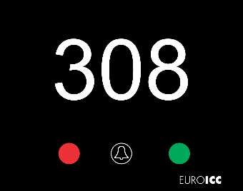

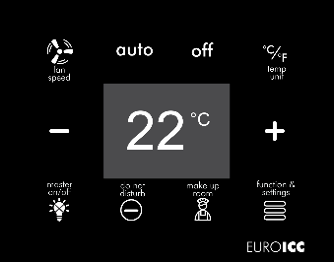

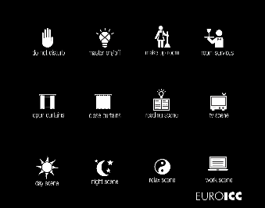
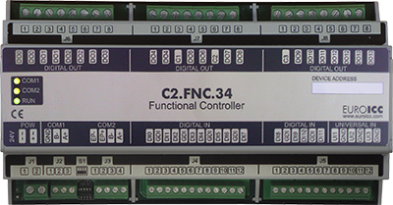
What we do?
New Builds
Guest Room
Control Systems
Energy
Management
Systems
Lighting
Controls
Integrated
Room Solutions
Corridor panel
Card holder
Thermostat
Wall panel
Wall panel

Slide 3
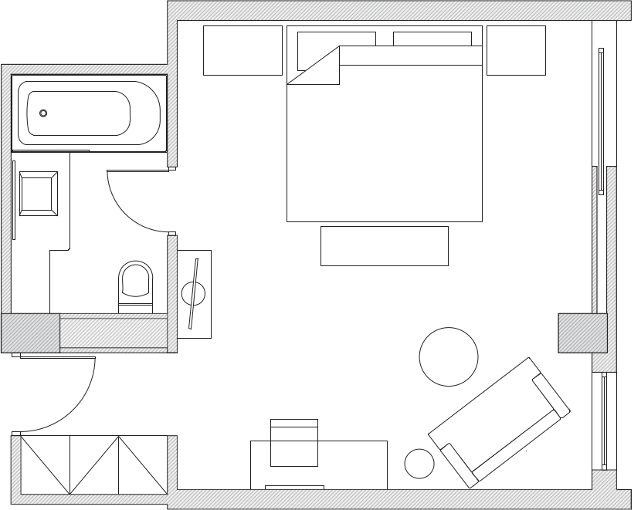


Typical Guestroom
E
E
D
A
Card reader
D
Thermostat
C
A
B
Card holder
E
Bedside Panel
Door Contact
B
Door Lock
C
Bathroom Panel

Slide 4
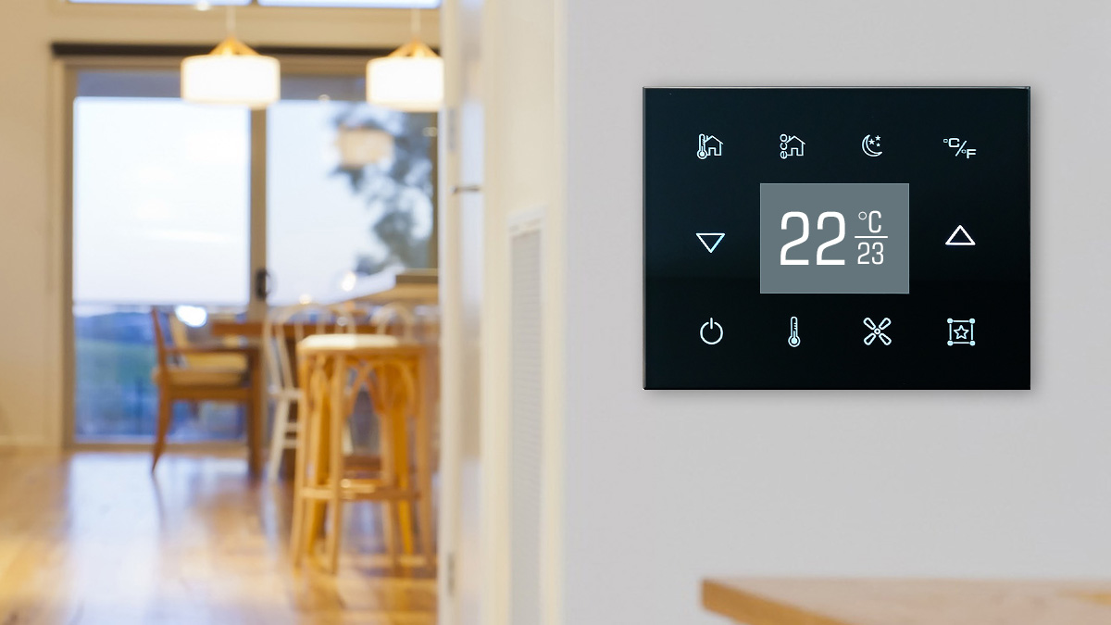
Usability and Guest Experience
as our core design principles

Slide 5
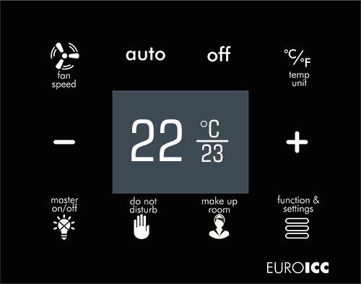
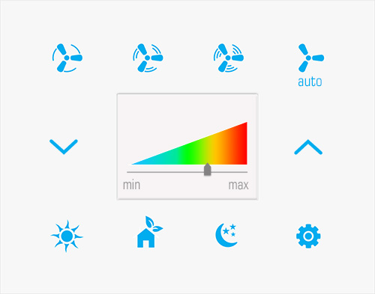
Guest Room Control Panels
Mix of icons and text
Backlight icons for easy use at night
Multi-color status LED
Multi use panels, lighting, Air Con, Guest Services

Slide 6
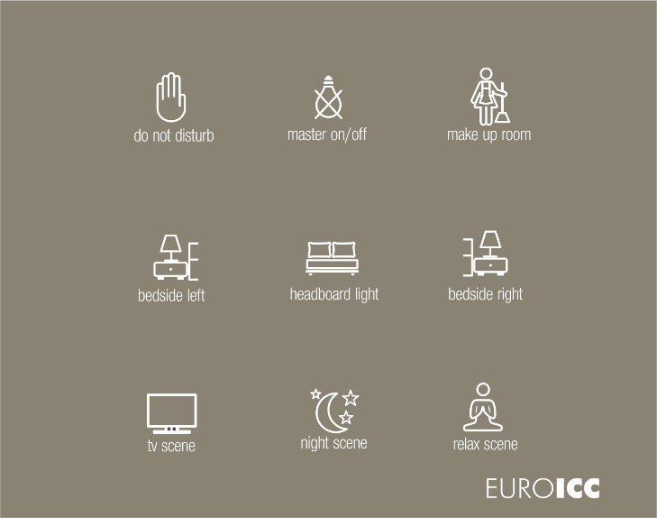
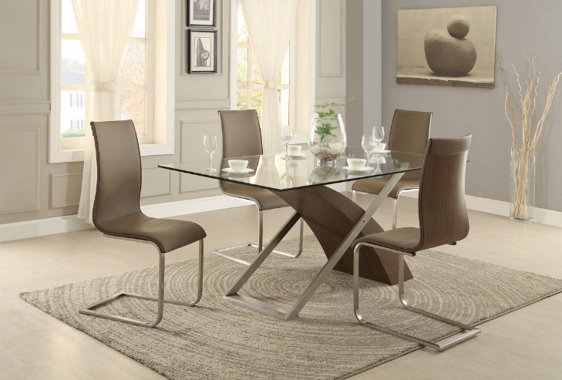
Design Capabilities
User interface
Focus on User-friendliness
Developed for hospitality environment
Icons allow quick and easy familiarisation
Text, fonts and icons are customisable
Look and Feel
Devices can be customised to match the interior design
Ability to incorporate logo or pattern prints
Panel devices with elegant look and pleasing light.

Slide 7
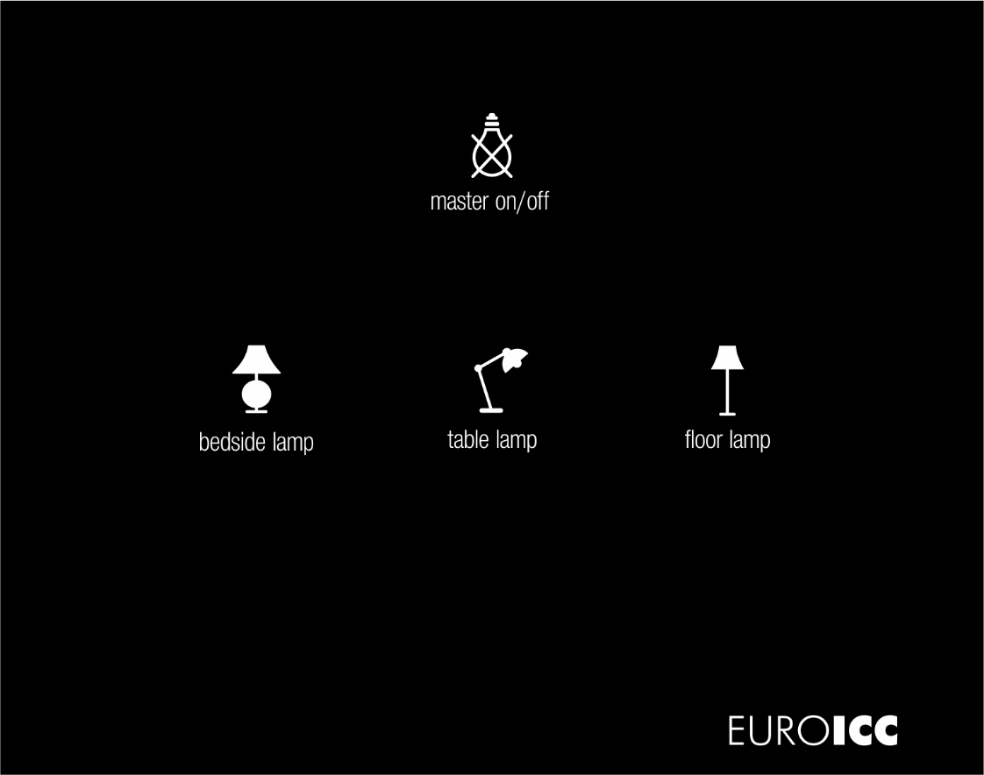
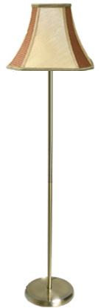
Design details
User-friendly and international
Icons that match the real-world FF&E help the user to understand immediately what he is controlling
Multilingual text labels make sure the system is being understood on international level

Slide 8
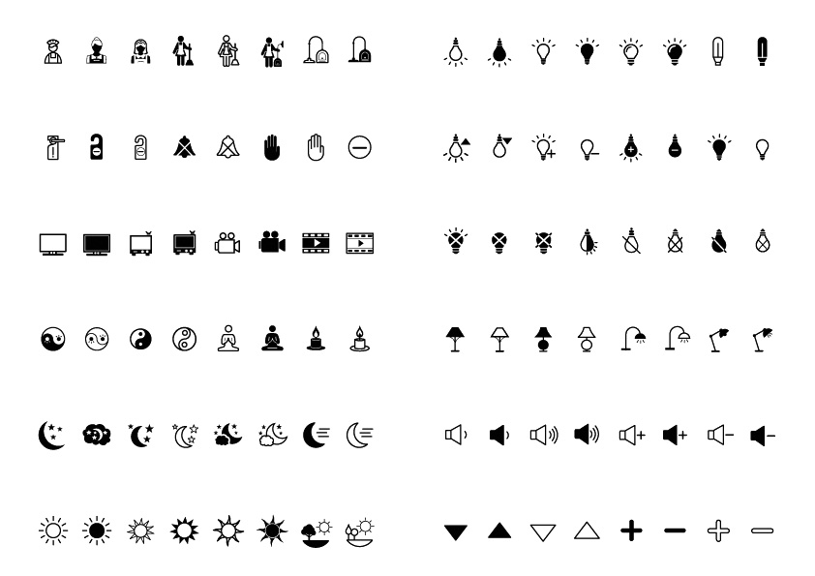
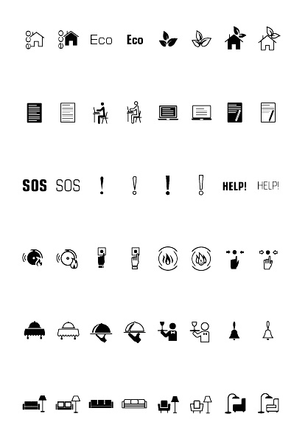
Copyright protected icons library
Constantly growing
Option to create brand specific icon sets

Slide 9
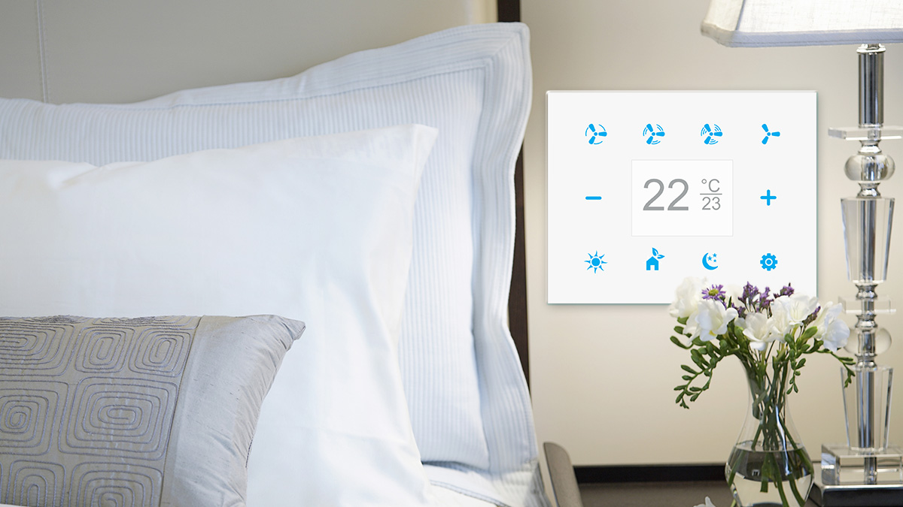
Network infrastructure, functionality, communication and devices

Slide 10
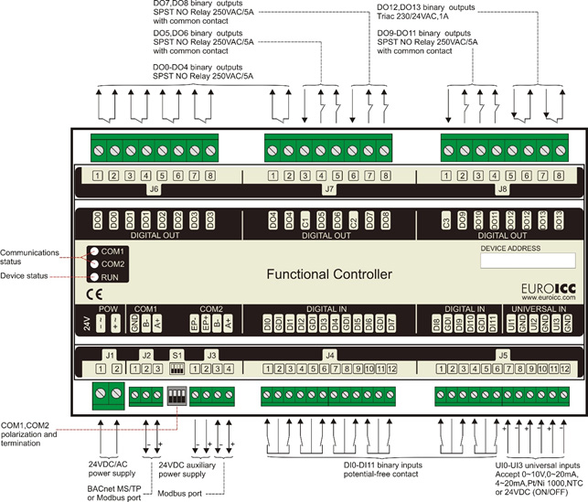
Functional Controller
The BACnet programmable functional controller is designed for wide range of building automation tasks. Its numerous inputs and outputs enable it to be used in many applications in building control while its BACnet connectivity enables seamless integration in Building Management System
Key features
8 independent SPST NO relays
2×3 group SPST NO relays
2 triac outputs
12 potential-free inputs
3 analog outputs
Programming is done using PC application
Resource sharing between controllers through BACnet network. Sharing of the data is performed without intervention of the supervisory system
Work plans stored in flash memory
RTC (real-time clock) with auxiliary battery power

Slide 11

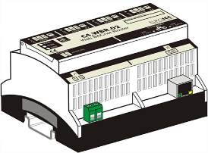
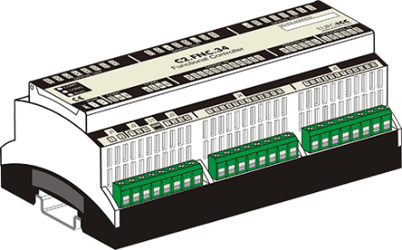



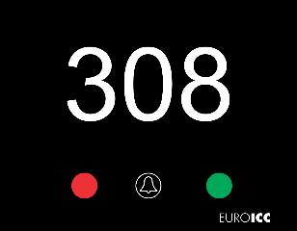

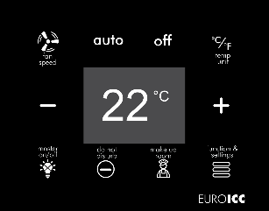
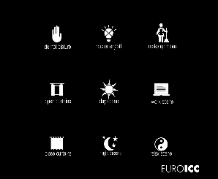

EUROICC System
On/Off Lighting Control
Sensors & Switches
Operator Console and Central Monitoring Platform
Applications, Interface with PMS and other 3rd parties
jPLCPro
All relays of the RCU are rated at 10A for resistive loads and 2A inductive loads
Door/Window Contacts, Pulse Switches, Motion Sensors
RMS Server
Thermoregulation
Fan Coil Unit
Control of floor heating, fan coil units, heaters, etc.
Actuator Valves
Control of on/off, floating and modulating valve actuators.
Hotel Converged
Network with RMS VLAN
TCP/IP Communication ensures reduced latency times
Curtain/Sheer control
Card Encoder
Multiple control options from 1 to 3 buttons with features like one-touch and hold/ release.
Primary Field Devices
RS 485 (Modbus)
Expansion Modules
Expansion Modules
System is scalable and modular to meet various requirements. Lighting Control capabilities include switching and dimming halogen and incandescent lights, LEDs, and Fluorescents. Supported dimming technologies include 0-10Vdc, leading edge dimming and trailing edge dimming. Supported Lighting protocols include DALI.

Slide 12
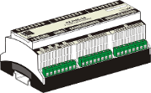
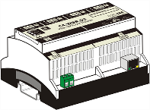








Network infrastructure
System Overview – Online Network
RMS Server Room & Operator Control Centre
Client for Frontdesk, Housekeeping, Engineering, Security, Management
Room 1
Room 2
Room 3
Room n
Telephone Room
Cloud
Floor n
Floor 3
Fiber Network Backbone
Supervisor
Control
Engine
Archive
Alert
Floor 2
Card Programmer
Network
Floor 1
Control and Command Centre (Operator)
MDF
(Server Room)
Saving on the Power Infrastructure
Separate VLAN for RMS
PMS – BMS
IPTV
Disaster
recovery
EUROICC
RMS

Slide 13
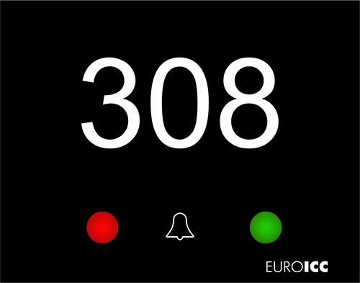
Corridor Status Panel
Status Panel is programmable card reader device designed for hotels. Its intended usage is to be placed in corridor beside room door. The device can provide additional functionality thanks to the one pushbutton and 4 LED indicators. The device can communicate with Mifare 1K RFID cards.
Supports Mifare 1K RFID card
Additional functionality provided by pushbutton and LED indicators
Configuration, programming and debugging is done using PC based tool through USB port
Resource sharing between controllers through BACnet network. Sharing of the data is performed without intervention of the supervisory system
Jumper selectable standard polarizing and termination resistors on RS485 terminal

Slide 14

Card Holder
Card Holder is a programmable device designed for hotels. Its intended usage is to be placed in the room entrance near the door. The gap for card has backlight. The device can communicate with Mifare 1K RFID cards.
Supports Mifare 1K RFID cards
Card gap has backlight
Configuration, programming and debugging is done using PC based tool through USB port
Resource sharing between controllers through BACnet network. Sharing of the data is performed without intervention of the supervisory system
Jumper selectable standard polarizing and termination resistors on RS485 terminal

Slide 15
Thermostat
Programmable home thermostat can be used for control of various air conditioning and heating systems such as fan coils, split systems etc.
Device features QVGA (320x240) TFT color display, 10 capacitive keys with two color dimmable backlight and embedded temperature probe.
The device communicates with the rest of the system using RS485 port.
The device can provide additional functionality thanks to a collection of analog and digital inputs and outputs.

Slide 16
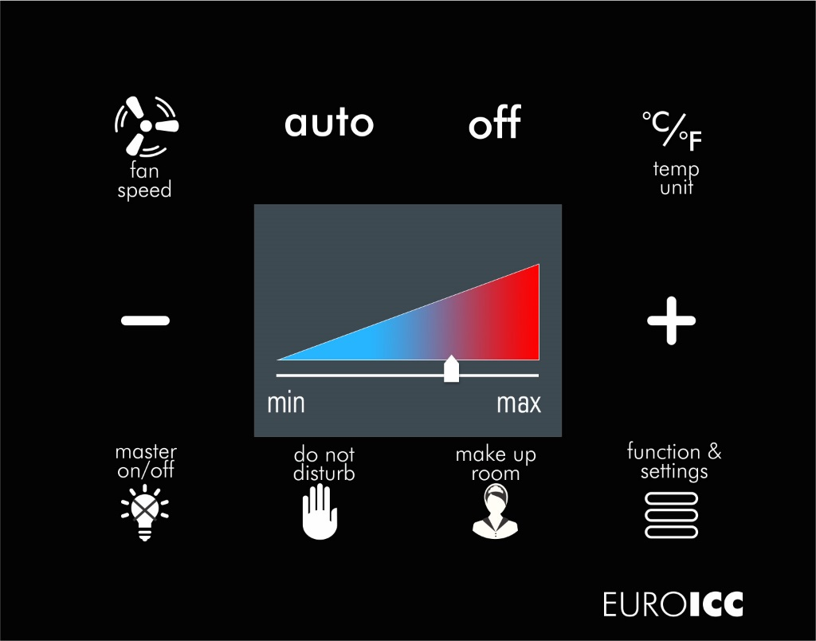
Thermostat
Color display
10 capacitive keys with bicolor backlight
Embedded temperature probe
High level of flexibility thanks to a wide range of IO resources
Configuration, programming and debugging is done using PC based tool through USB port
Resource sharing between controllers through BACnet network. Sharing of the data is performed without intervention of the supervisory system
Jumper selectable standard polarizing and termination resistors on RS485 terminal

Slide 17
Eco Comfort
28°C
26°C
24°C
Booking
Check-In
Long Term Room Vacancy
(more than 2 days)
Short Term Room Vacancy
(Within 2 days)
Welcome Temperature/
Room Empty Temperature
26°C
24°C
22°C
Check Out
Guest Leaves Room
Guest Presence
Room Vacancy Temperature
(Short-Term)
Non-occupancy Temperature
Guest Presence
Comfort Temperature

Slide 18
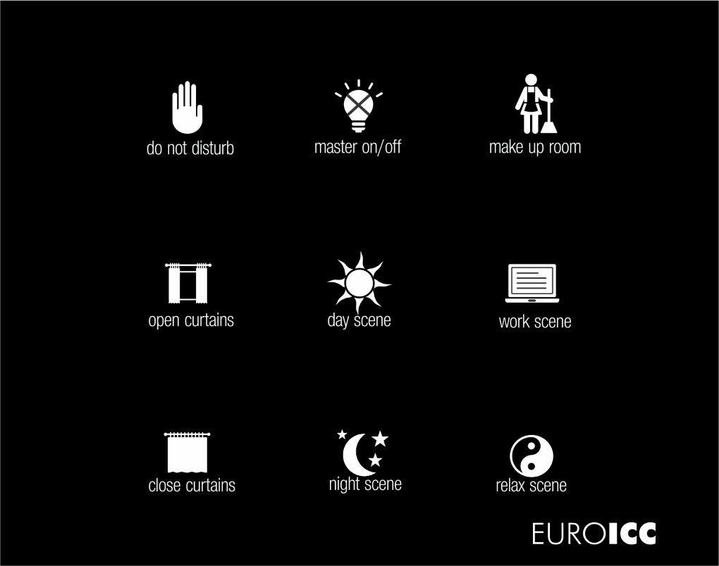
Wall touch panels
Wall touch panel is a programmable keypad unit for use in hotel rooms or home. It can be used as user interface in various automation systems.
Device features 9 or 12 capacitive keys with two color dimmable backlight.
The device communicates with the rest of the system using RS485 port.
9 or 12 capacitive keys with bicolor backlight
Configuration, programming and debugging is done using PC based tool through USB port
Resource sharing between controllers through BACnet network. Sharing of the data is performed without intervention of the supervisory system
Jumper selectable standard polarizing and termination resistors on RS485 terminal

Slide 19
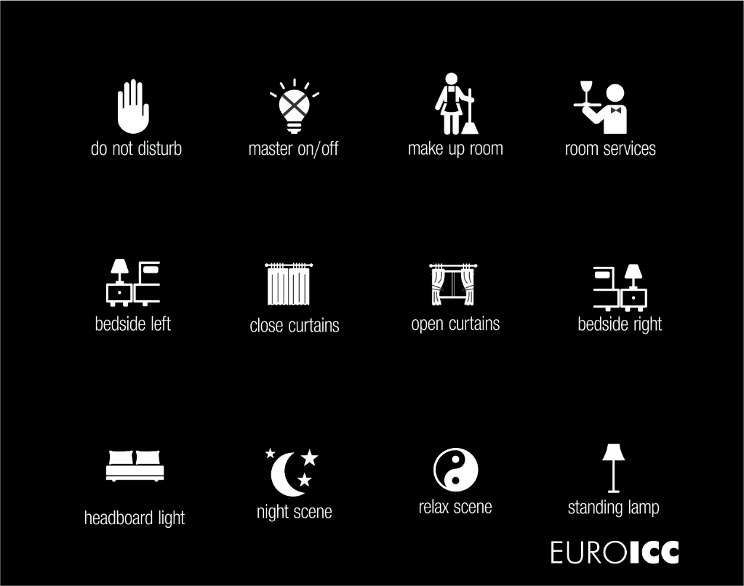
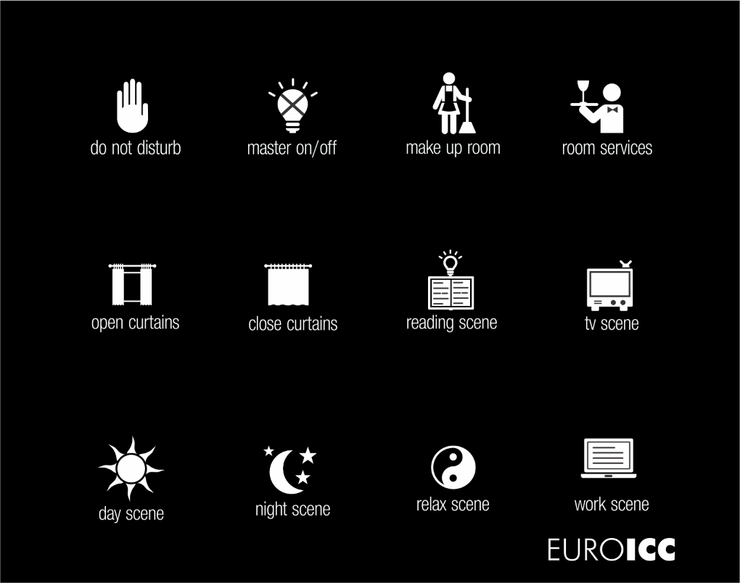
Wall touch panels

Slide 20
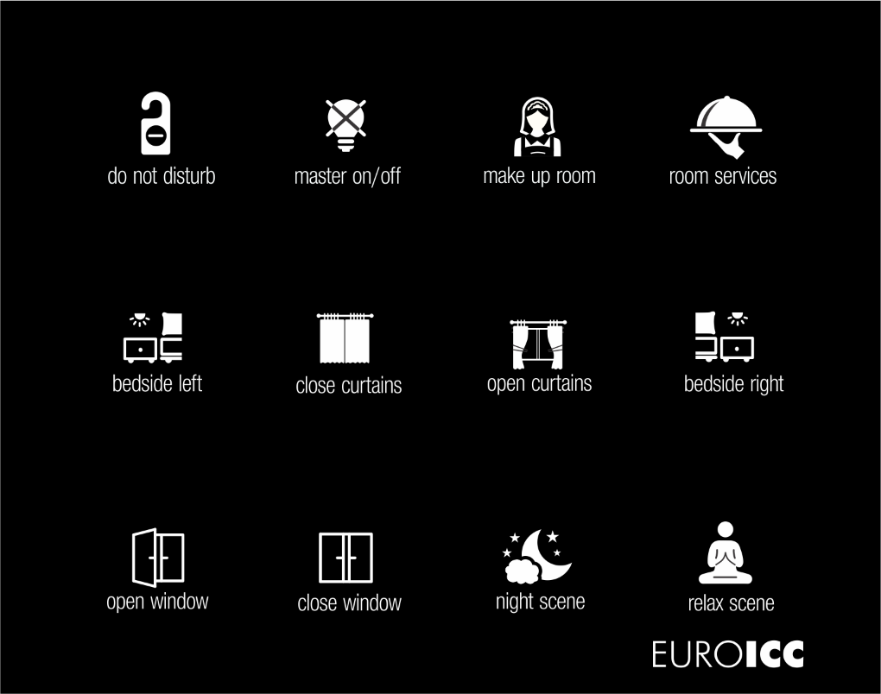
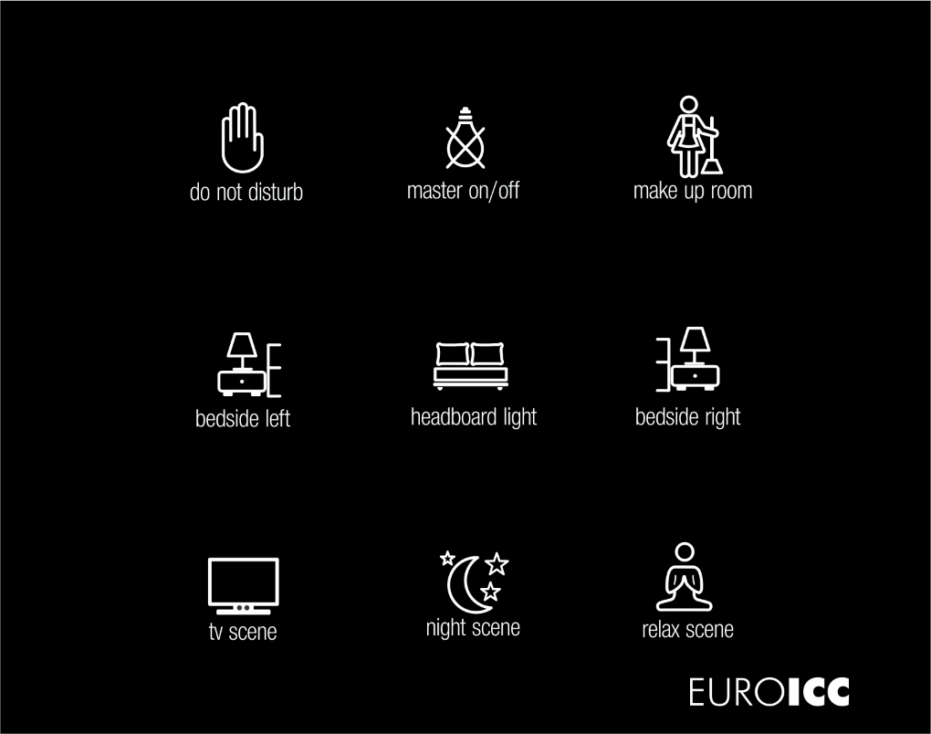
Wall touch panels

Slide 21

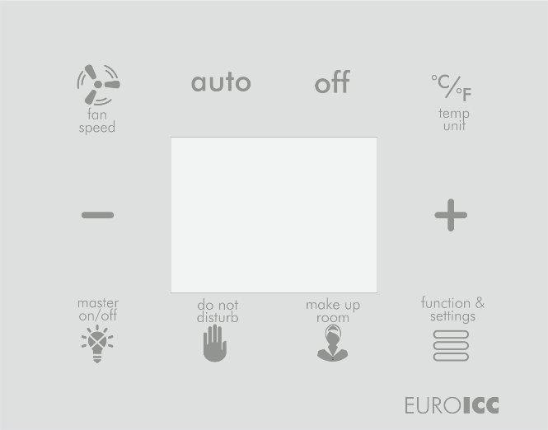

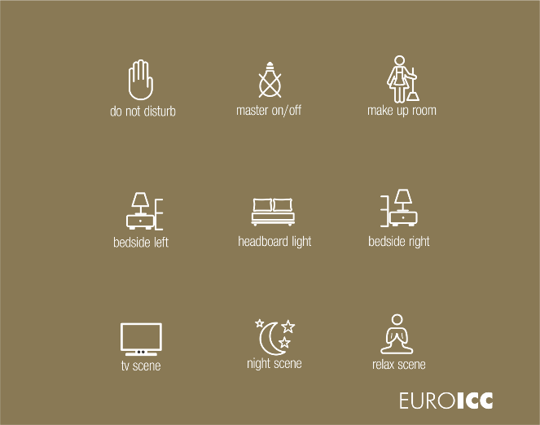
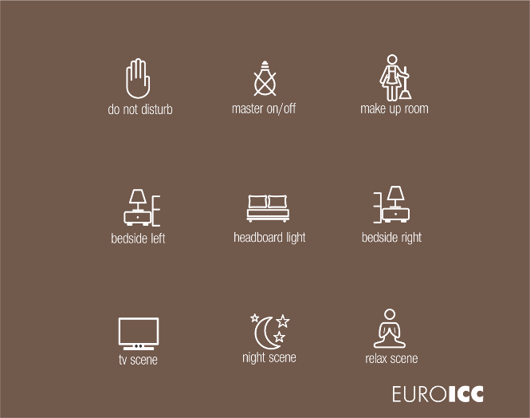

Design customizations

Slide 22

Thank you for your attention.
Any questions?
This presentation, including any supporting materials, is owned by EUROICC. and/or its affiliates and is for the sole use of the intended EUROICC audience or other authorized recipients. This presentation may contain information that is confidential, proprietary or otherwise legally protected, and it may not be further copied, distributed or publicly displayed without the express written permission of EUROICC or its affiliates.
© 2017 EUROICC. and/or its affiliates. All rights reserved.

